Slide 1
NBA Draft Patterns
Li Cai Haney and Elizabeth Love

Slide 2
Dataset
Basketball Reference, Sports Reference (International Stats)
“Age” is taken February 1 of the basketball season for draft year
2001-2020 Draft
Picks 1-60: 1191 Rows of Data
Minnesota forfeited the 29th overall pick in 2001 and 2002
How have draft picks changed over the last 20 draft picks and how are players used, particularly from an age, years of college, and draft pick round perspective?

Slide 3
Average Age of Draft Picks Over the Years

Slide 4
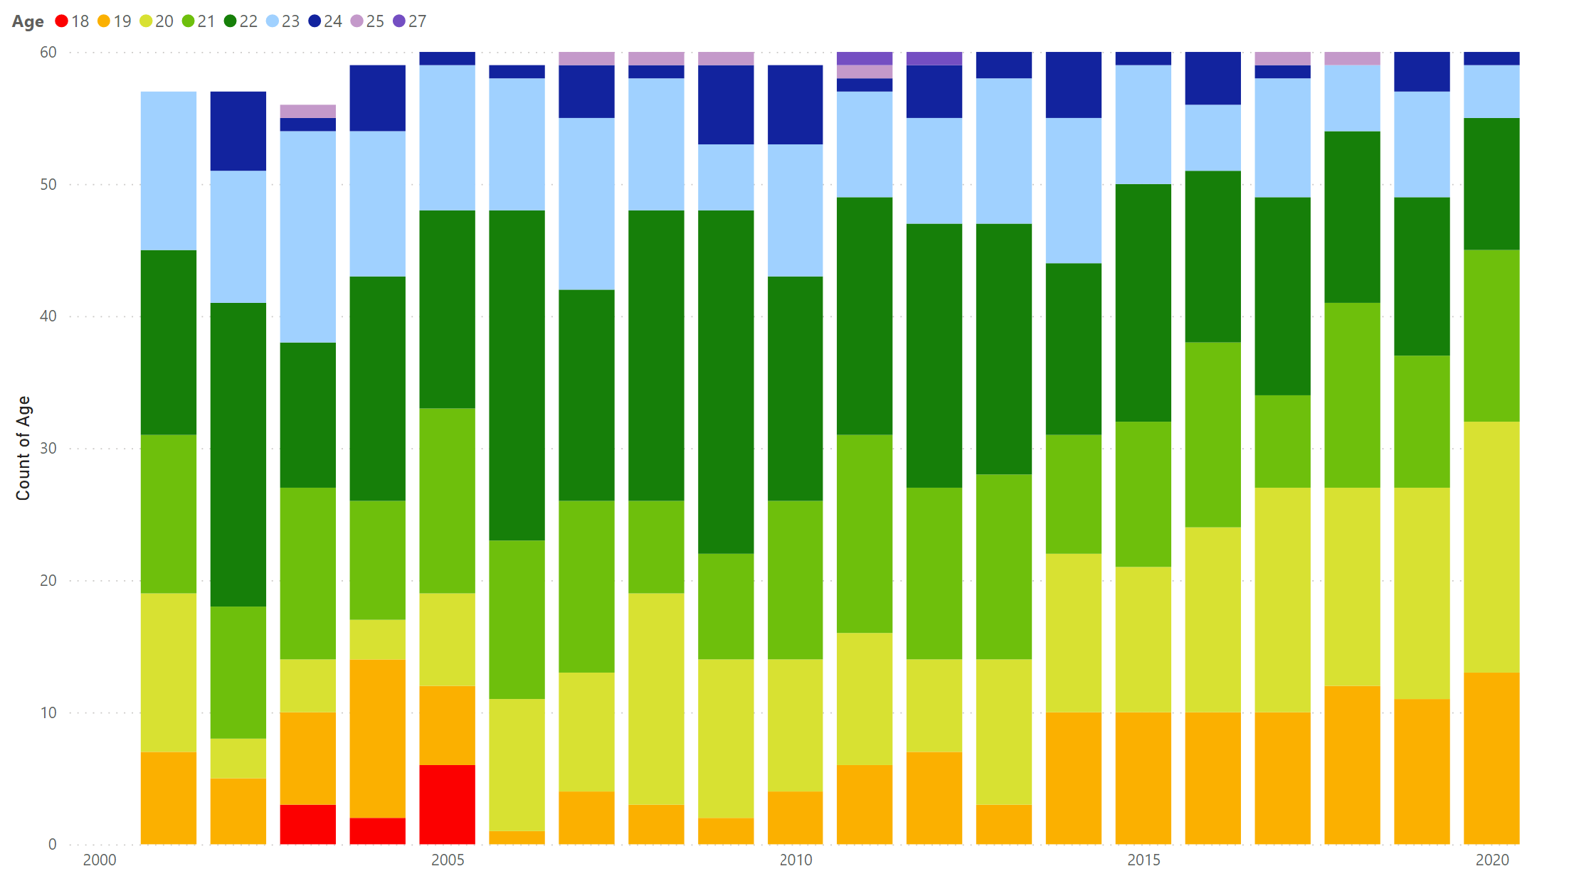
Age Breakdown of Draft Picks Over the Years
Draft Year

Slide 5
Average Age of Players By Round

Slide 6
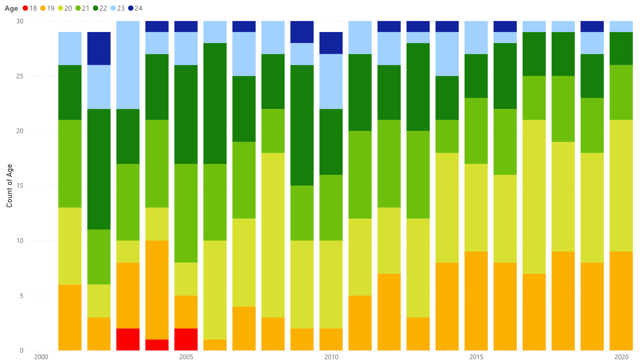
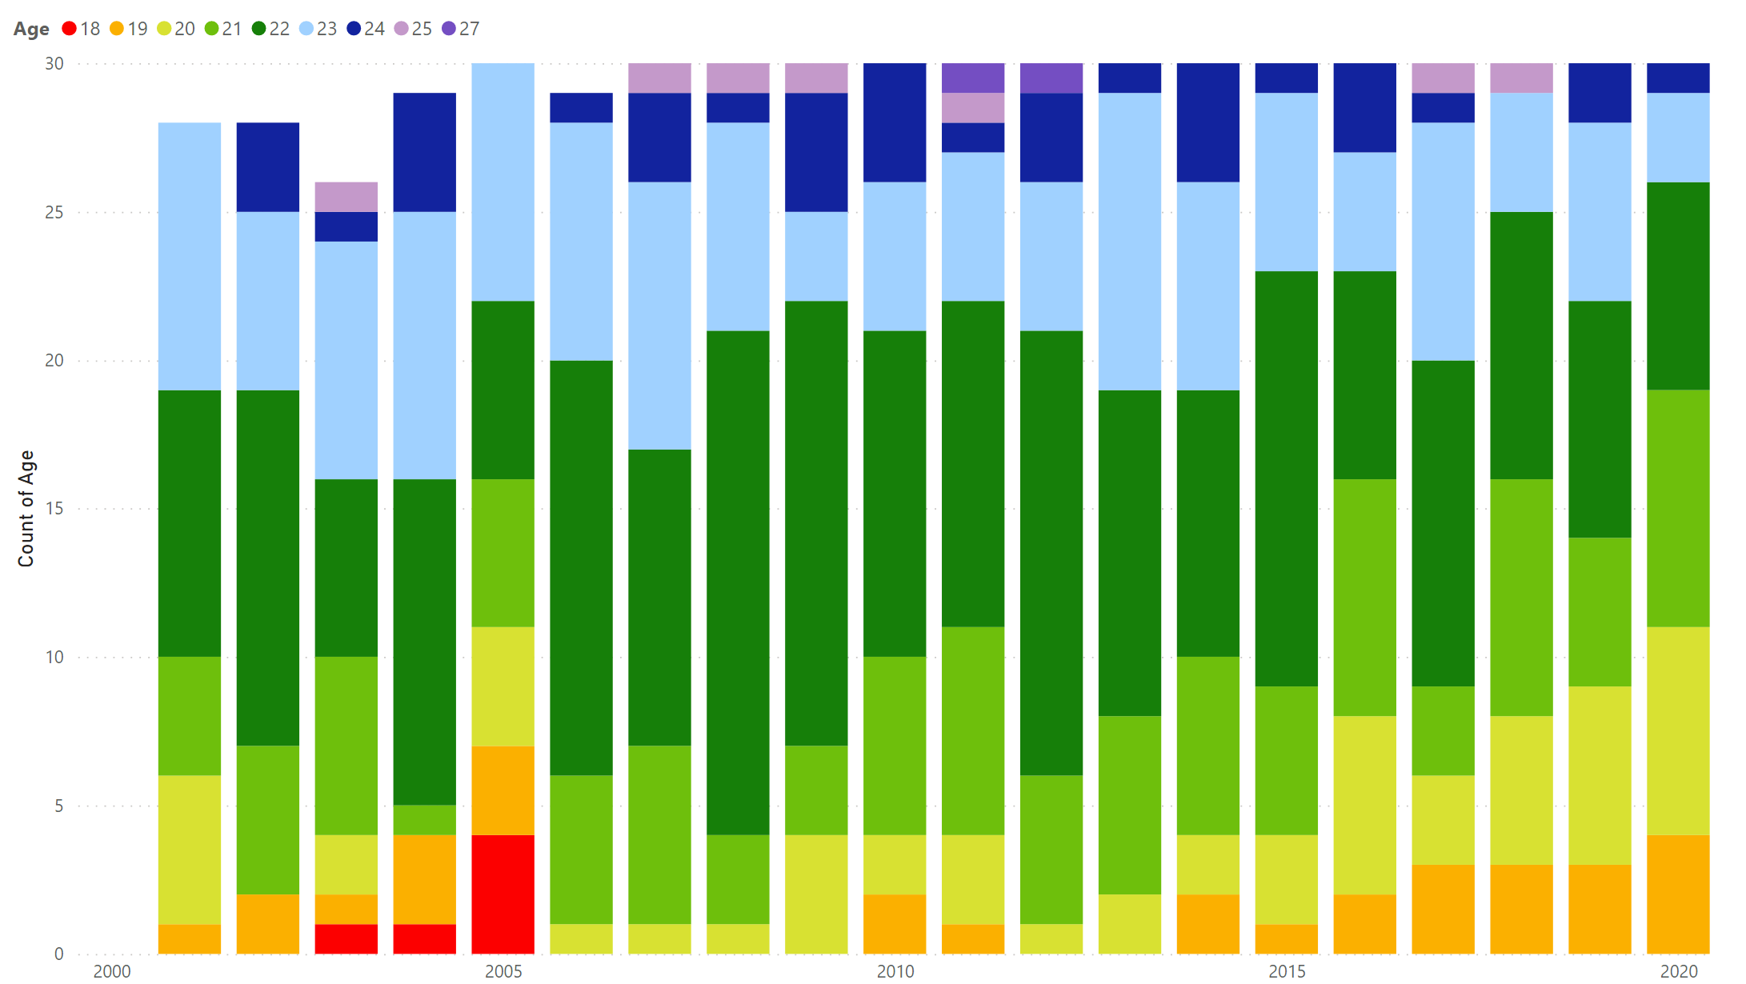
Age Breakdown by Draft Round
Draft Year
Draft Year
First Round
Second Round

Slide 7
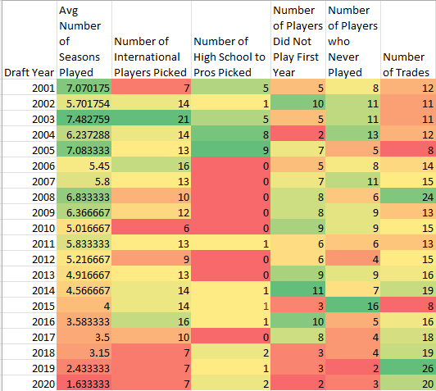
Draft Pick Summaries
Recent decrease in international players
Starting to have more domestic players who skip college
NIL Effect?
Fewer players are not playing first year in NBA
Fewer international players
More trades with drafted players

Slide 8
International Players

Slide 9
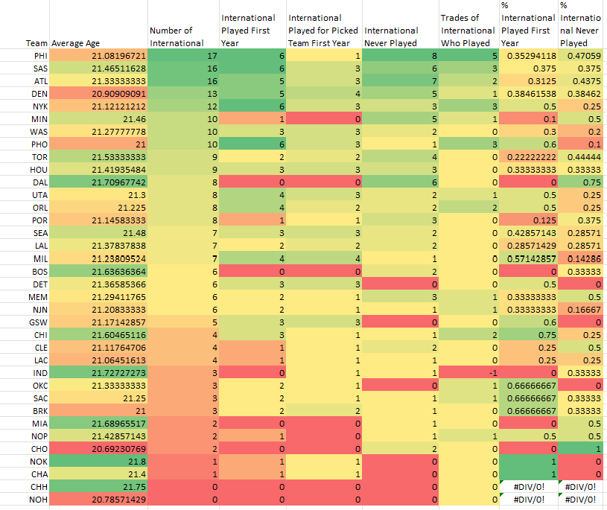
International Players by Team
Typically, international players do not play first season
Top 5 teams who pick international players
25-48% of international players do not play
≤50% play for team first year

Slide 10
Number of Years of College of Draft Picks

Slide 11
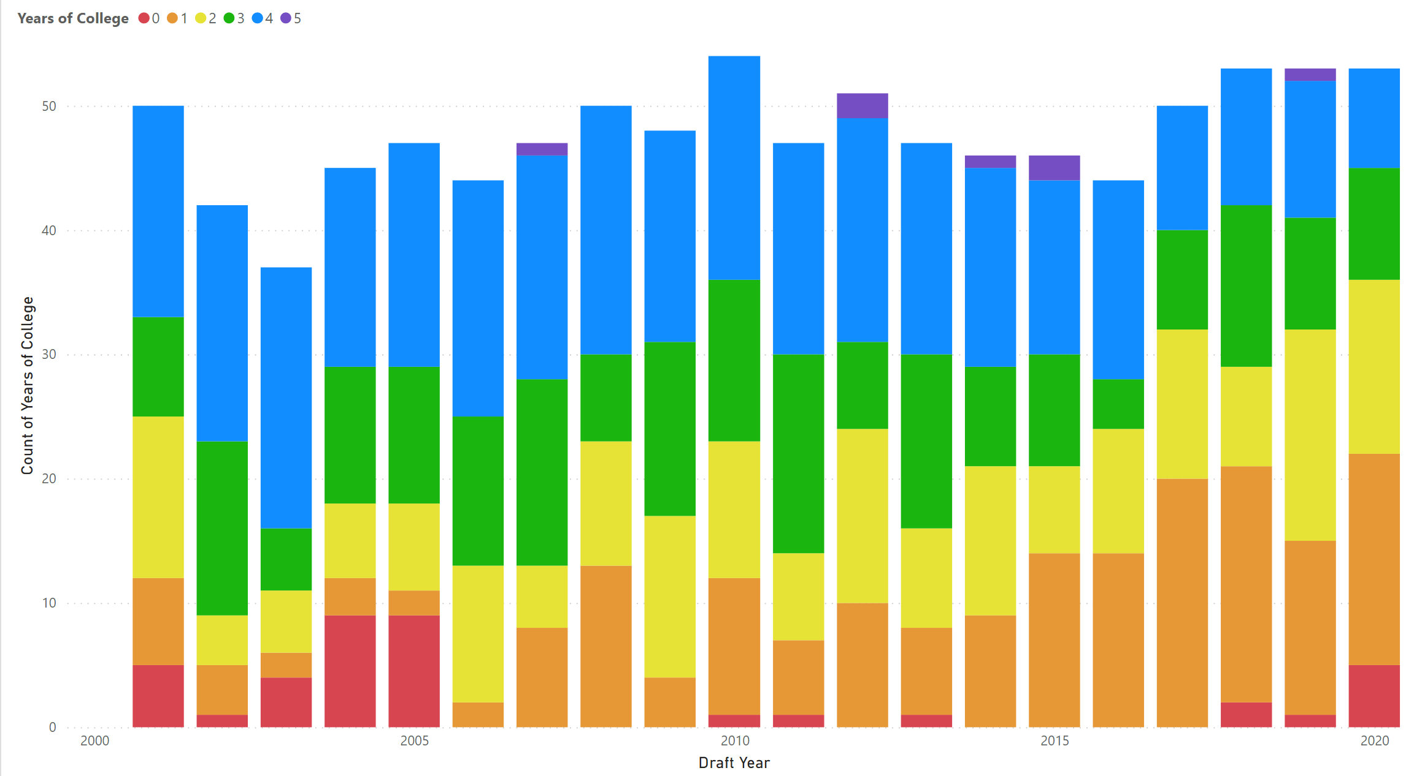
Years of College Breakdown

Slide 12
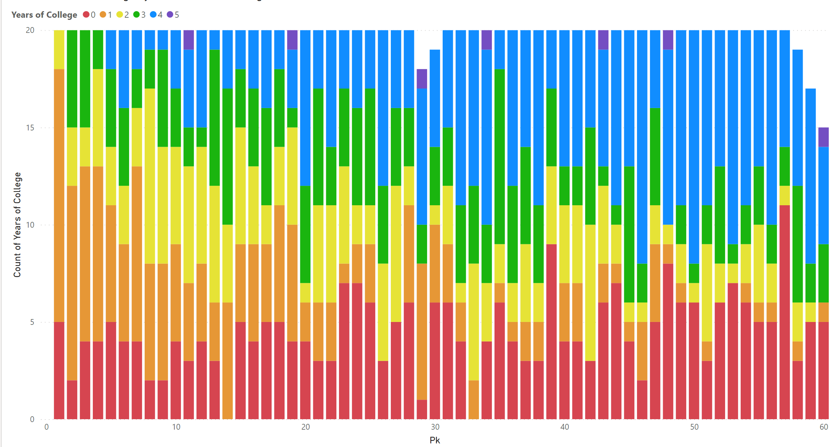
Years of College Breakdown

Slide 13
Draft Picks-MPG and PPG (College)

Slide 14
Draft Picks-MPG vs PPG in NBA (First Season)

Slide 15
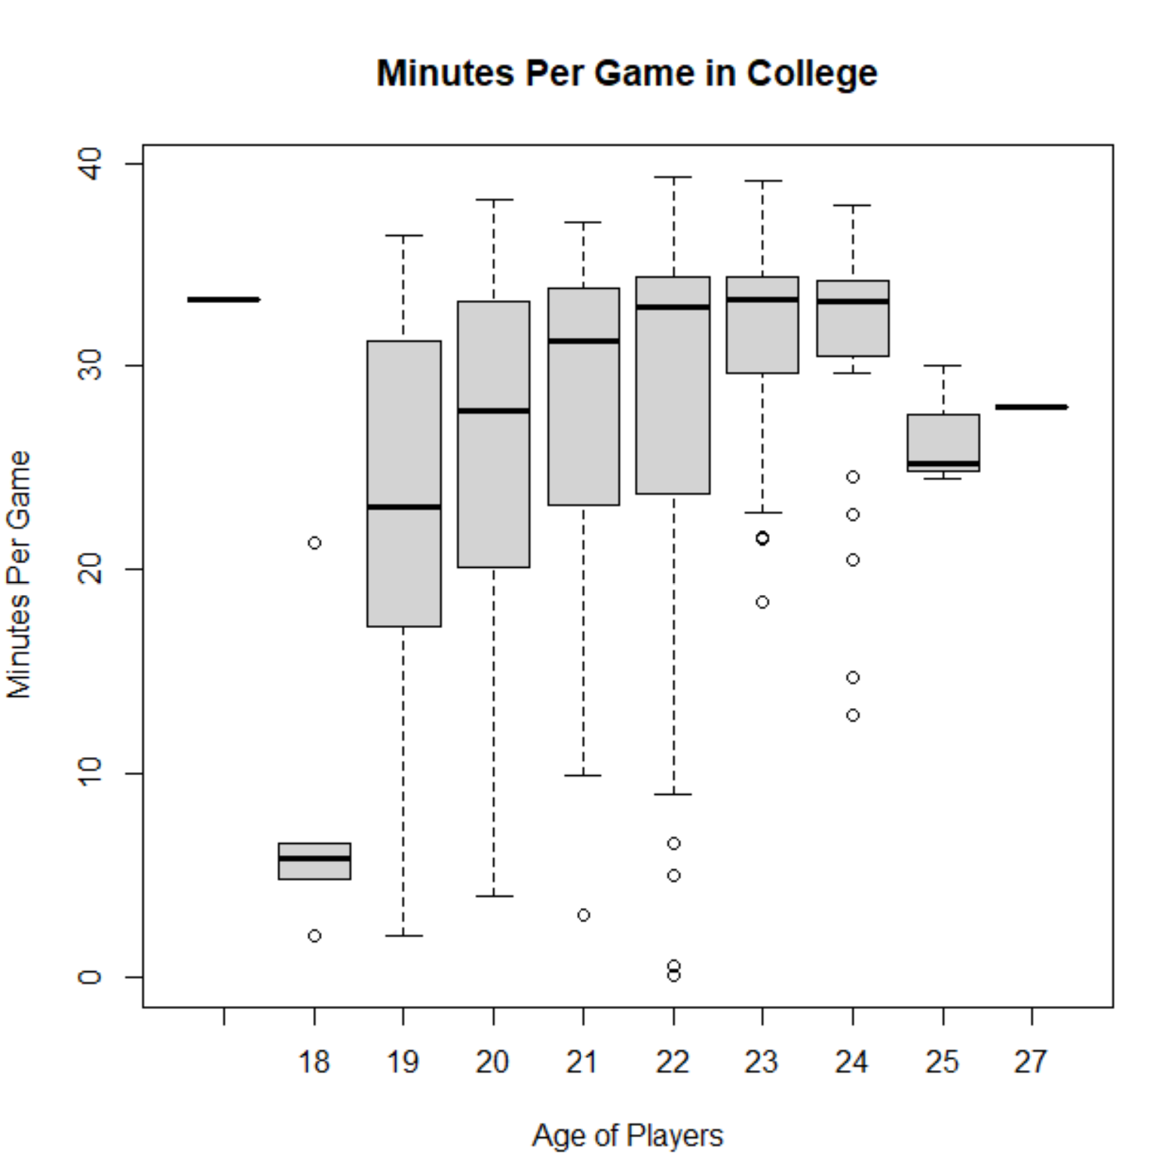
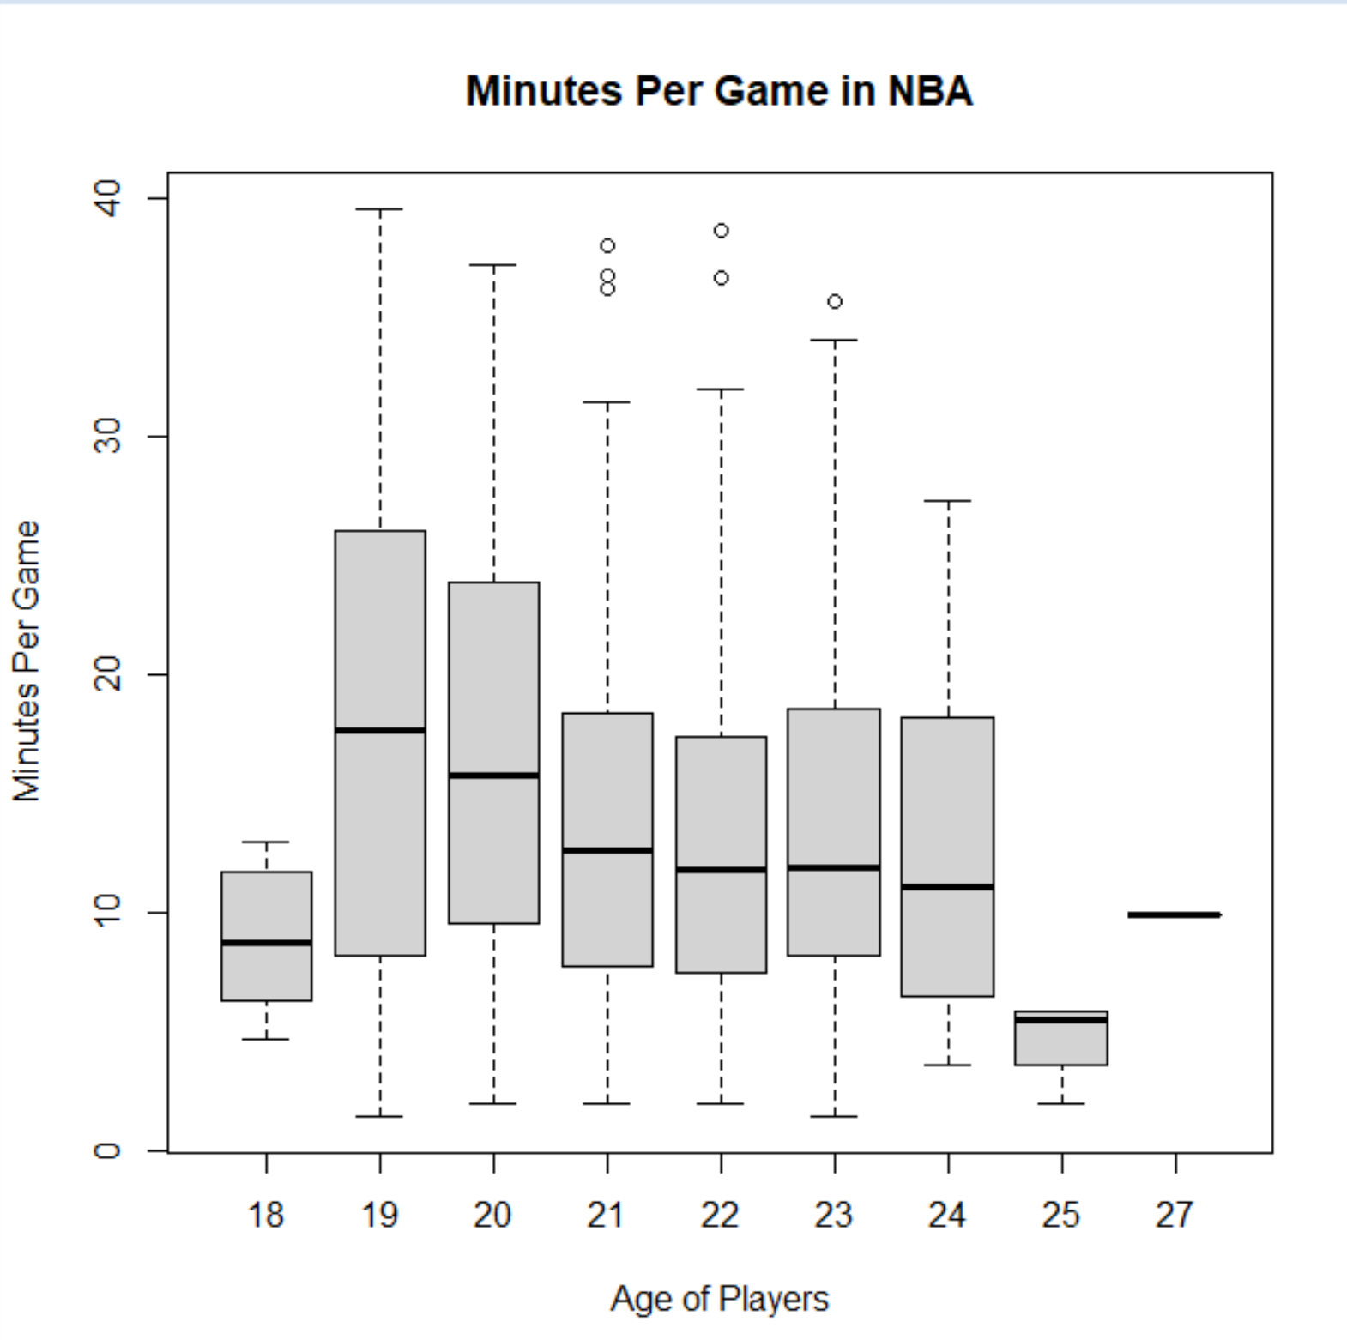
Minutes Per Game By Age

Slide 16
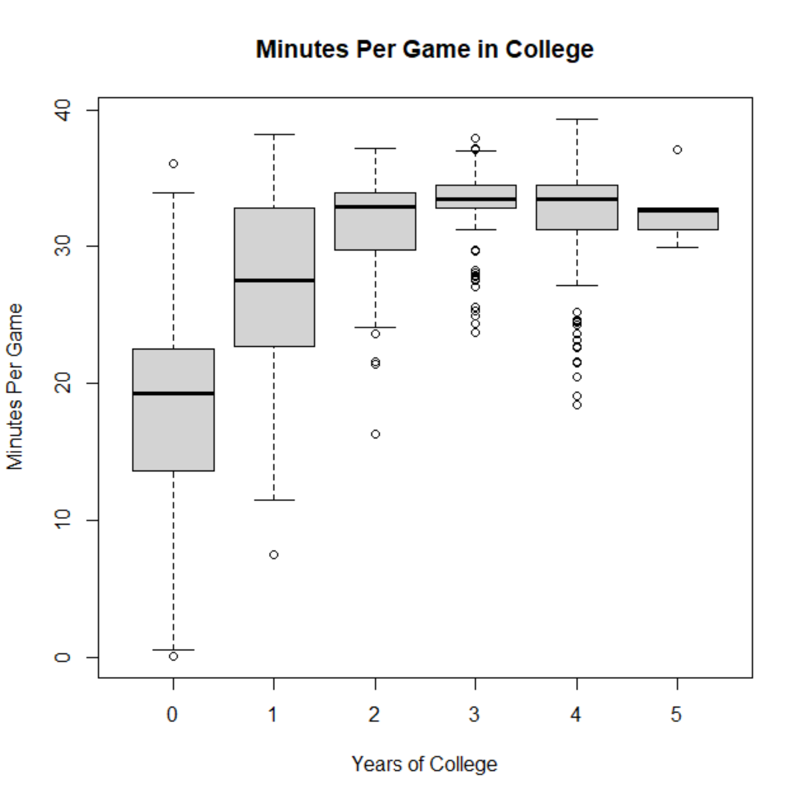
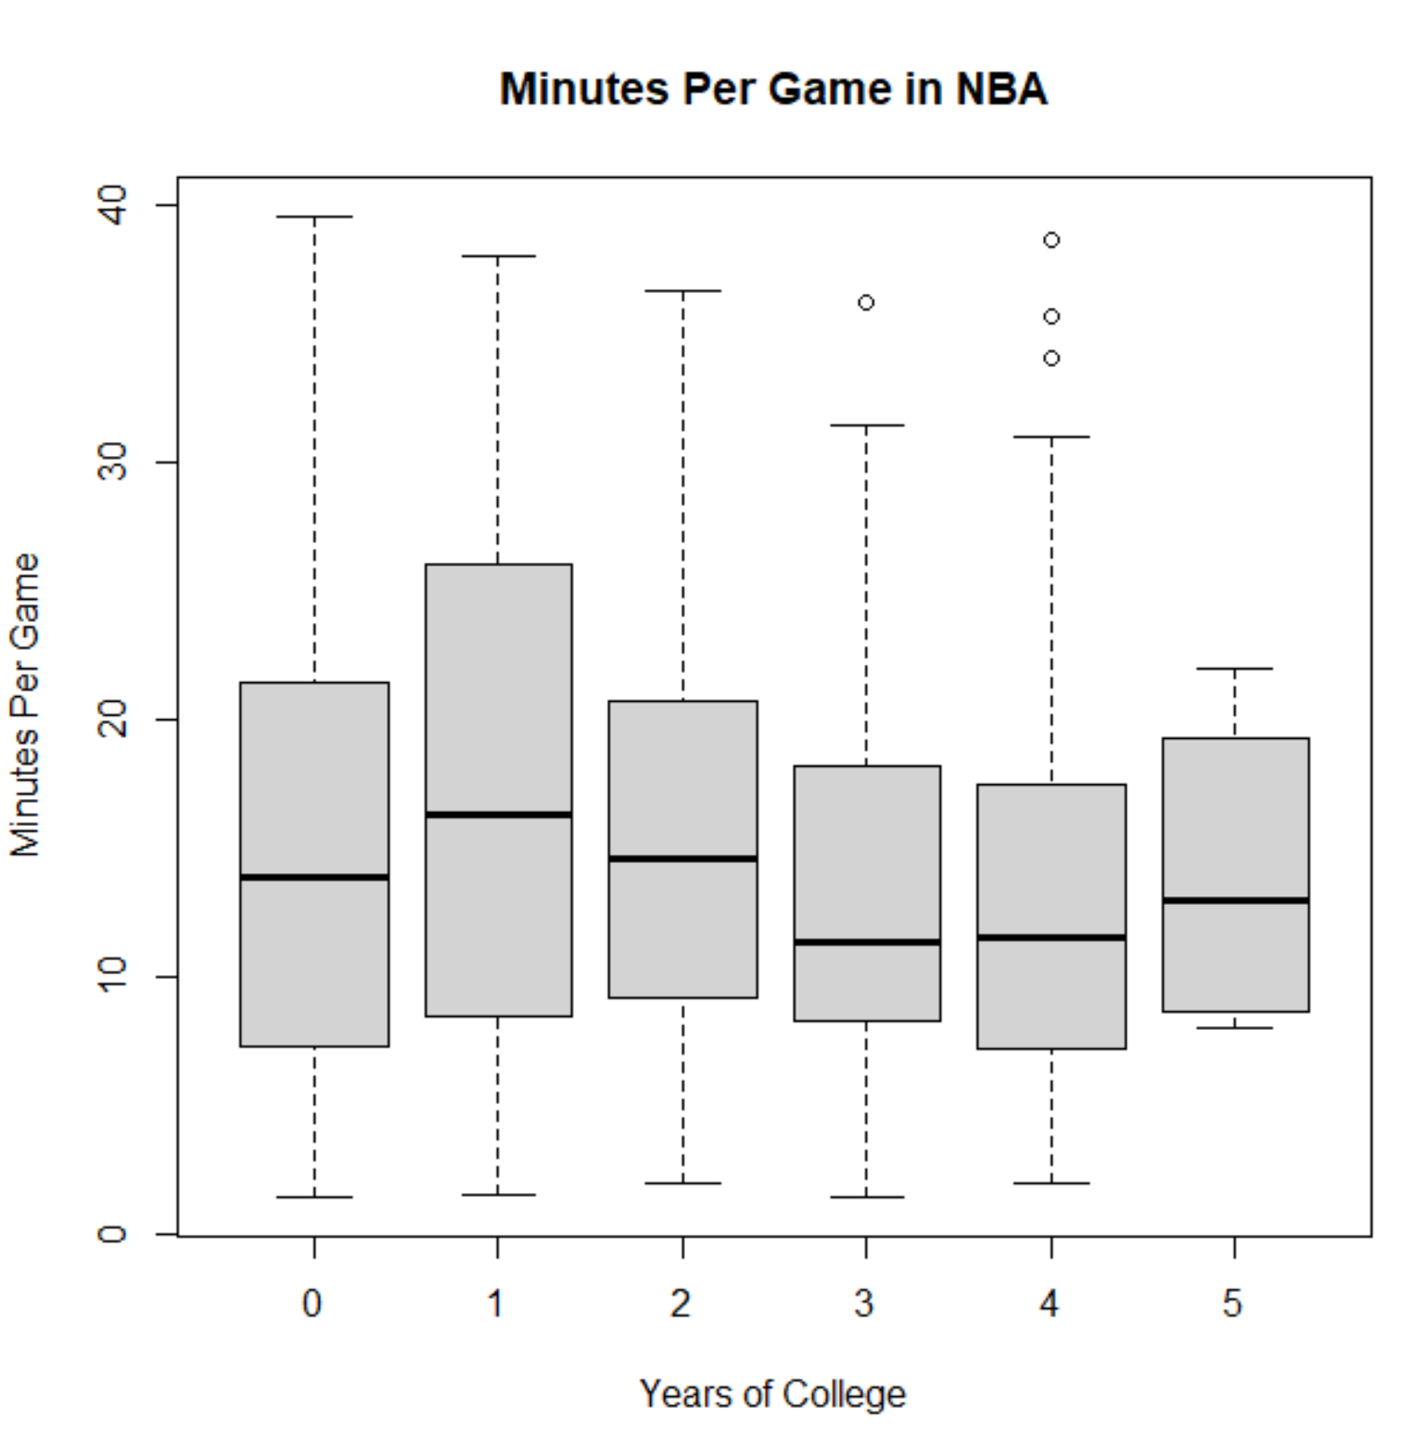
Minutes Per Game by Years of College

Slide 17
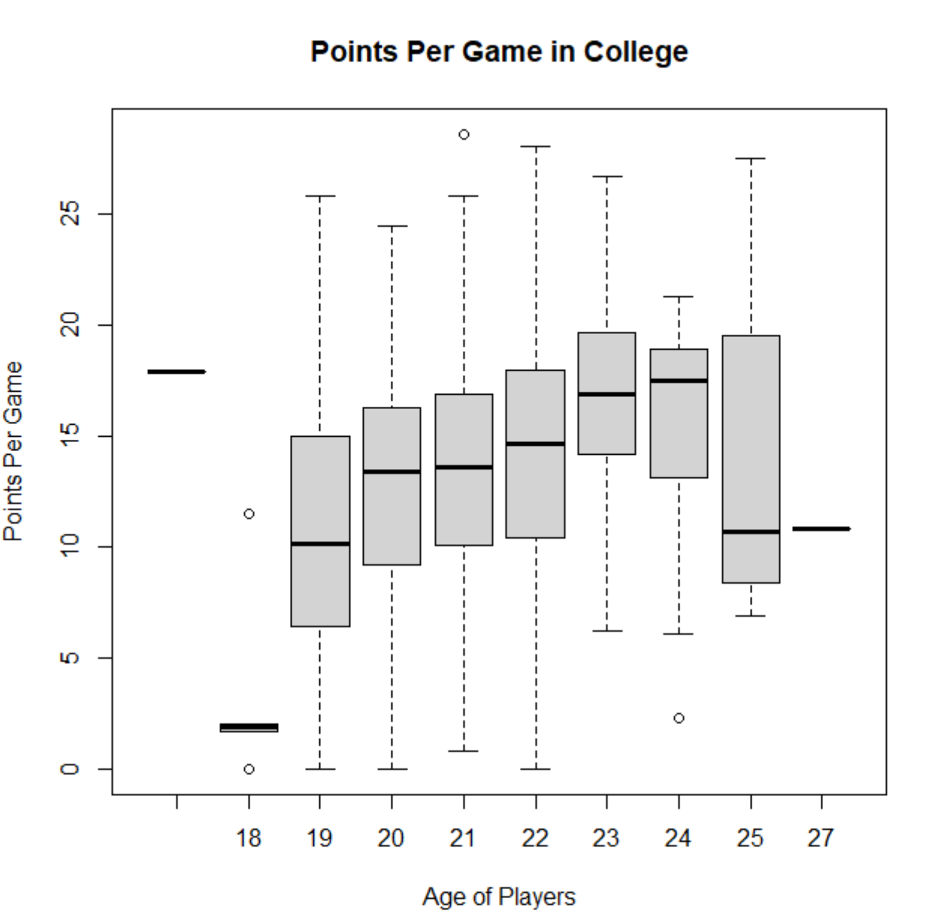
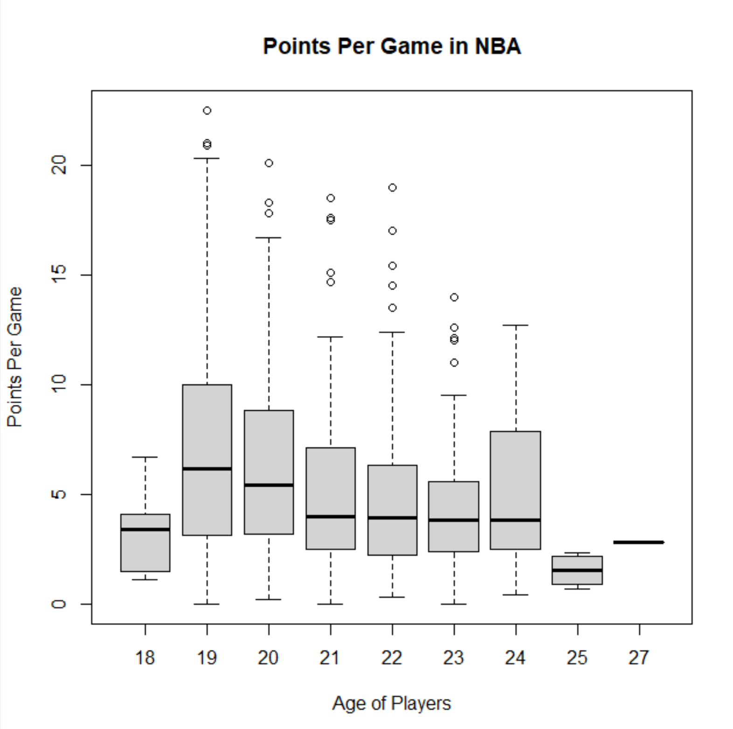
Points Per Game By Age

Slide 18
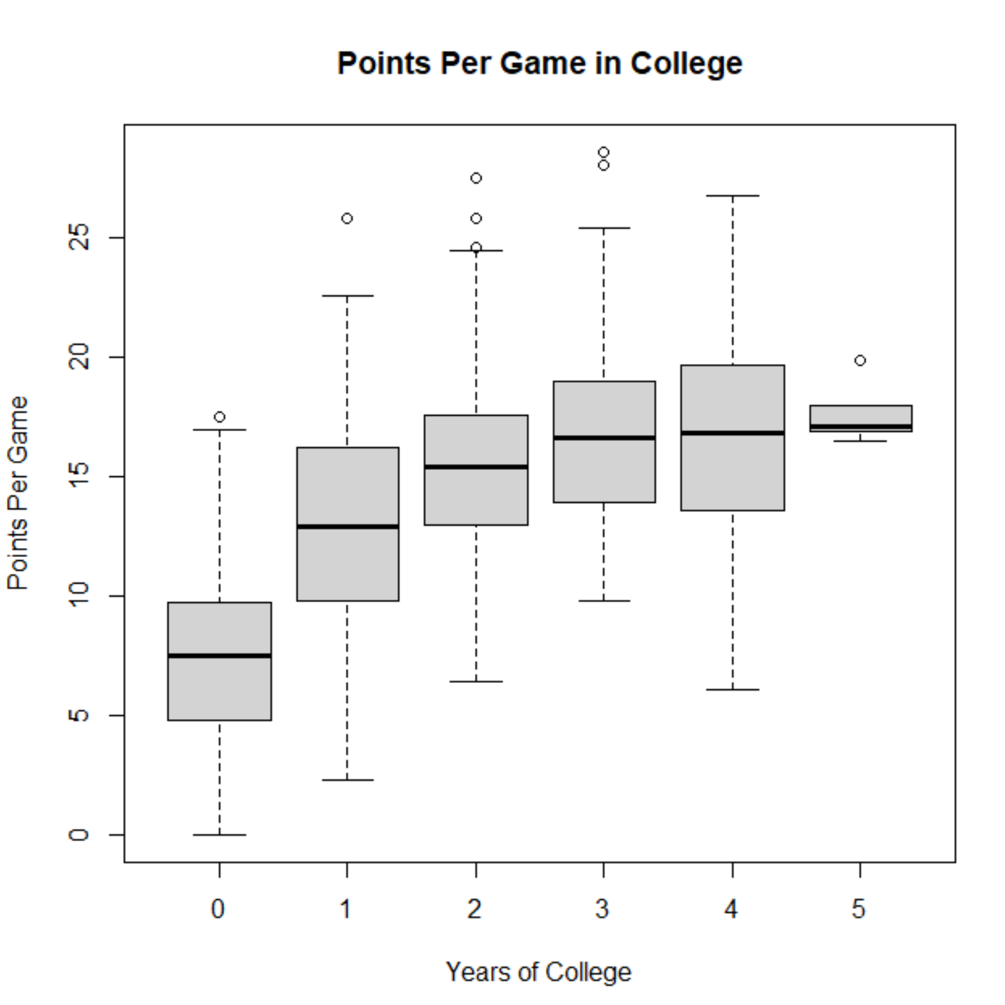
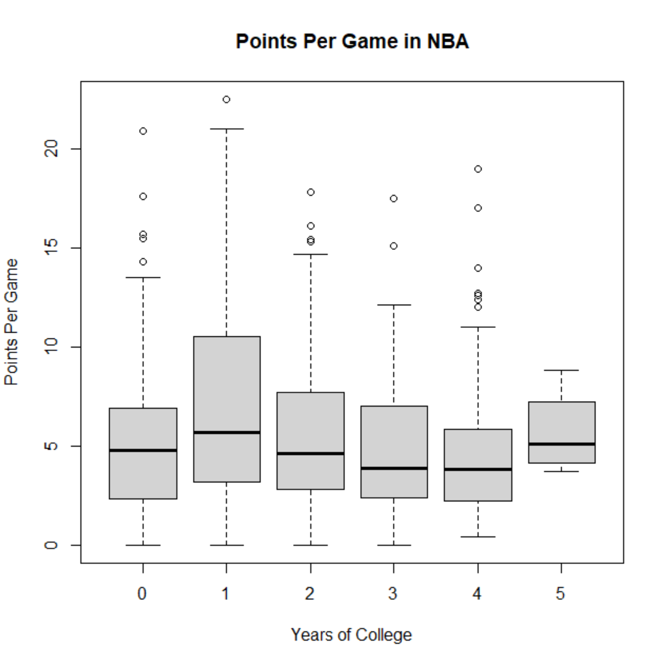
Points Per Game By Years of College

Slide 19
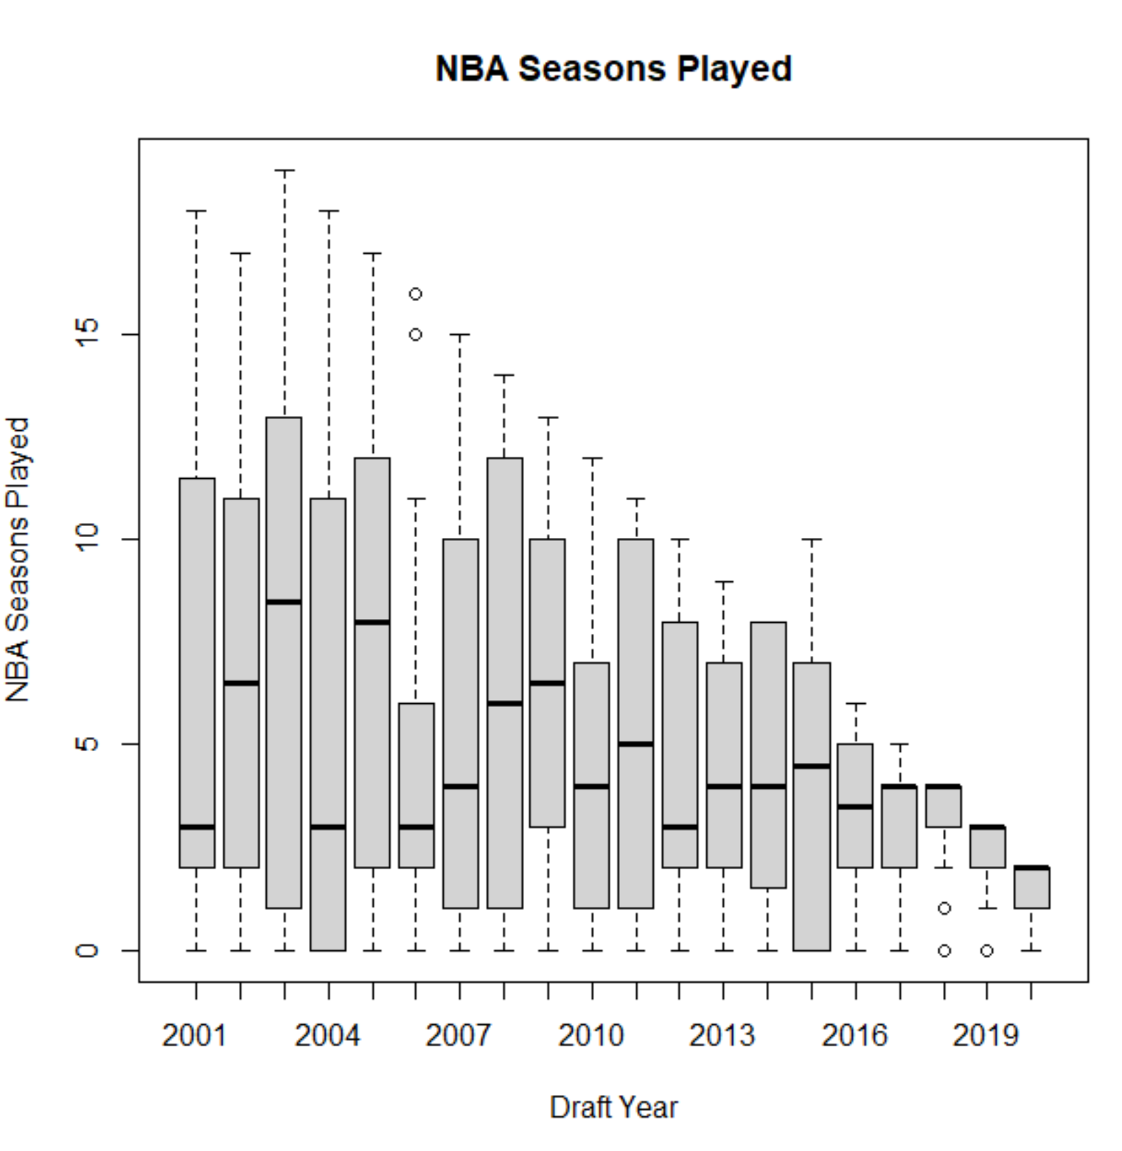
Seasons Played

Slide 20
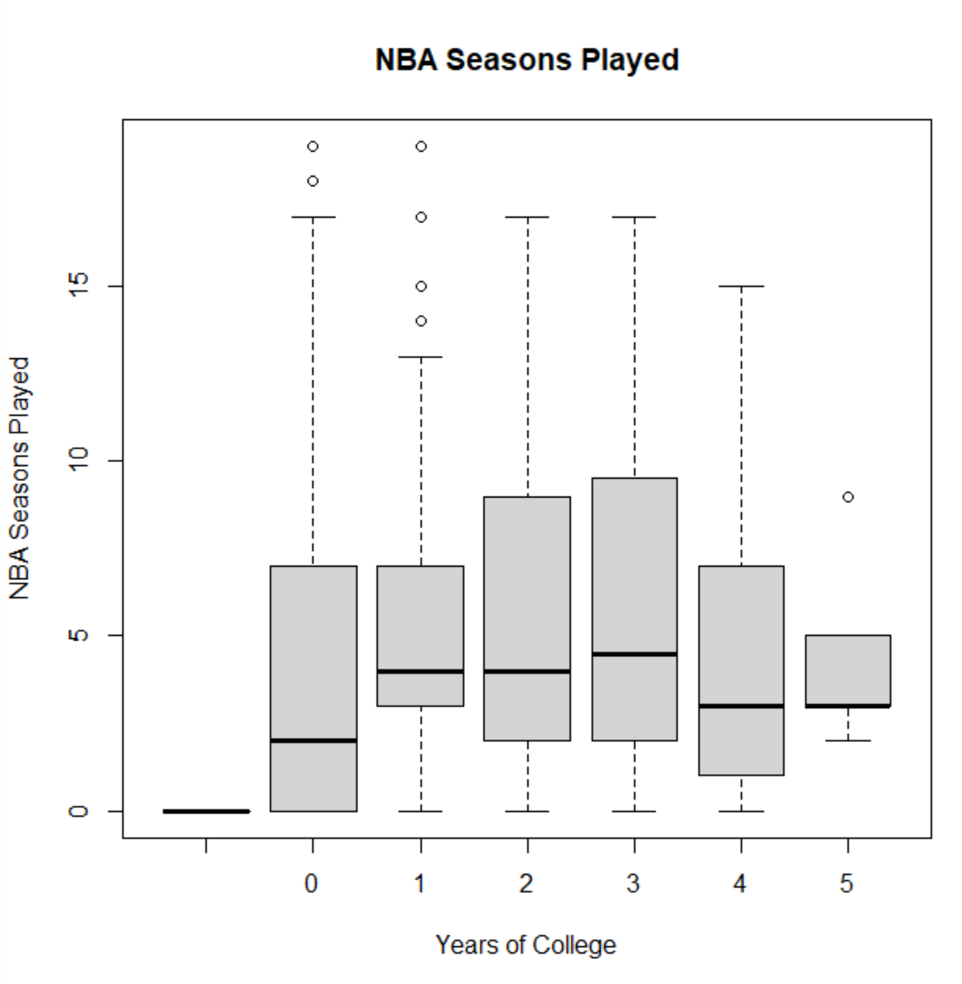
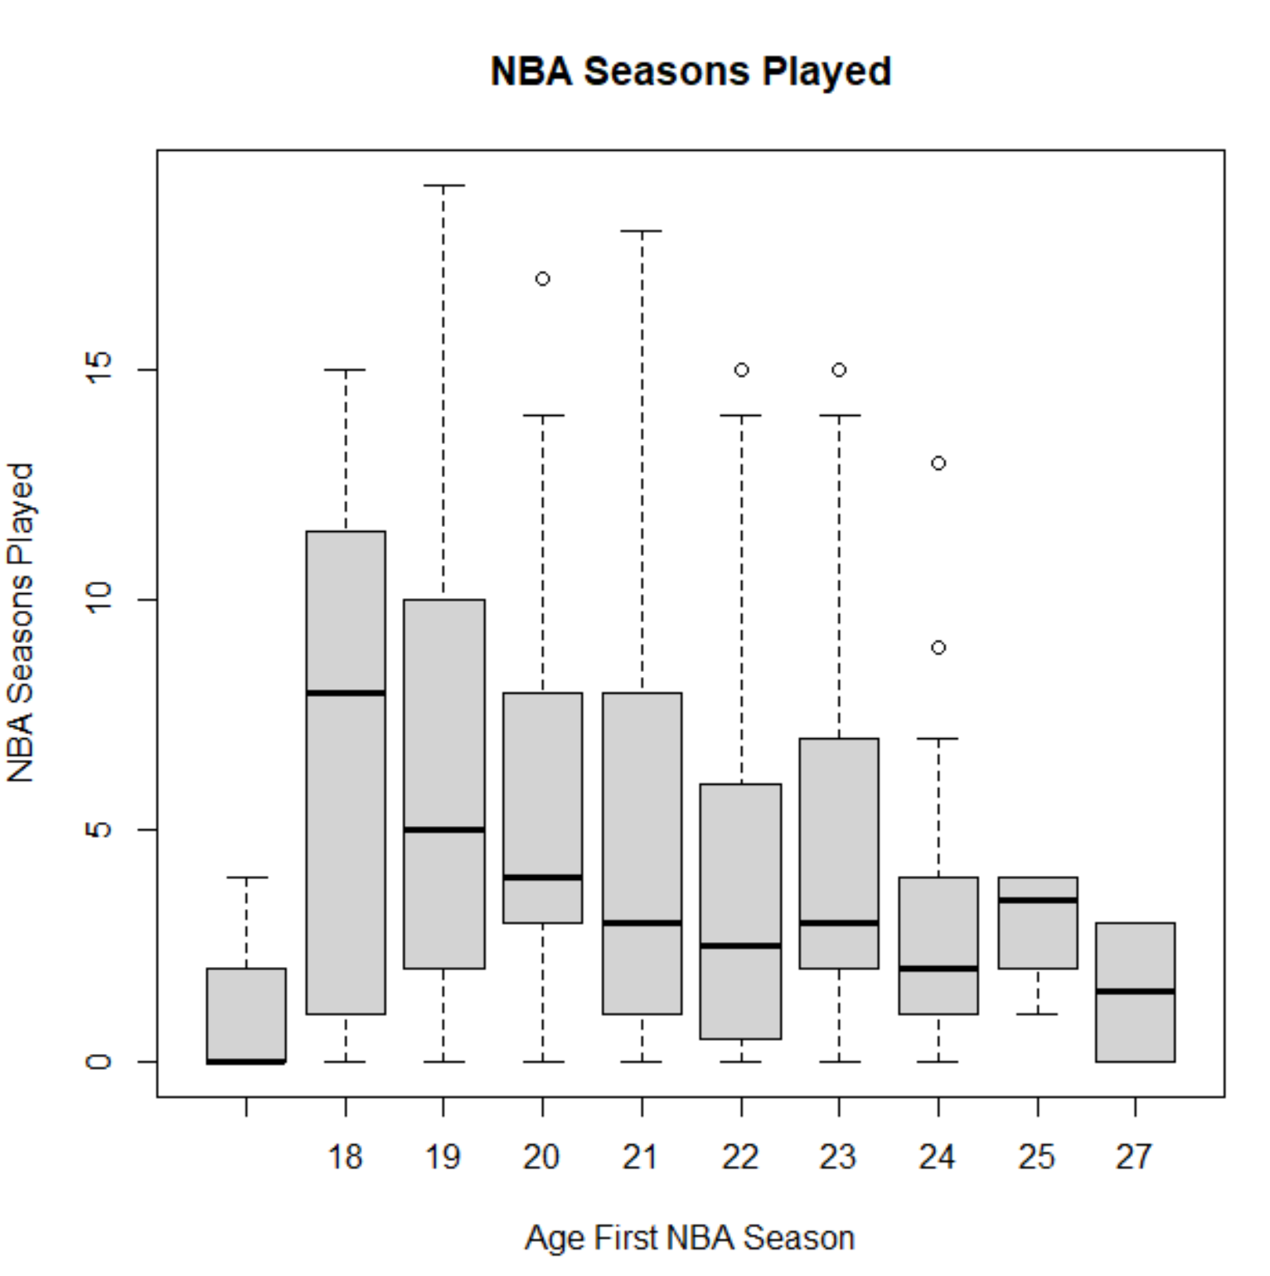
Seasons Played by Age and Years of College

Slide 21
Conclusions
Relatively small difference in average points per game and number of seasons played based on years of college
Some “one and doners” who do well and bring average points per game of 1 college year players up
Still not a very large average difference among players even with 1 and 2 college year players tending to play more minutes per game
Older players bring value to their first NBA season even with reduced playing time
Second round pick players do not receive as large a contract or play as well
NIL—incentive for two and three college year players to stay an extra year or two if they can earn money and potentially earn a higher draft number?

